Slide 1
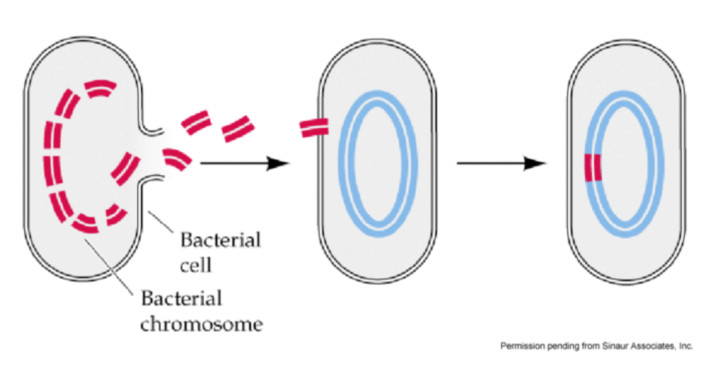
Bacterial Transformation Lab
Dr. Keller
In Nature: DNA from dead cells gets cut into fragments and exits the cell. The free-floating DNA can then be picked up by other bacterial cells and incorporated into
the host cell’s chromosome.

Slide 2
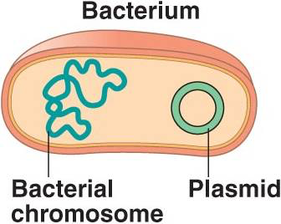
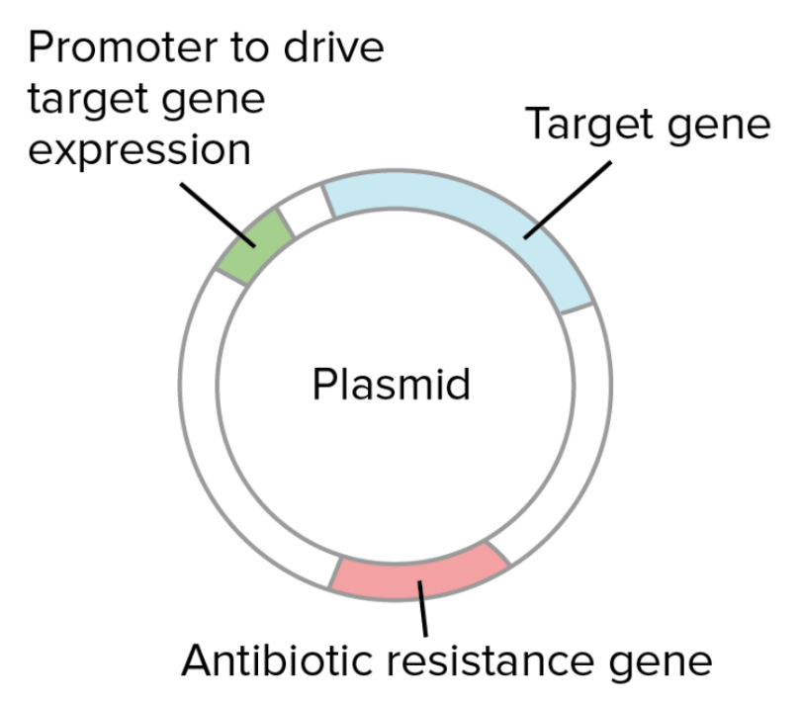
In the Lab: we utilize bacterial plasmids
Plasmid: a small, circular piece of dsDNA, distinct from the cell’s chromosomal DNA.
Elements of a plasmid:
Origin of replication (S-phase)
Restriction enzyme sites
Promoter
Target gene
Antibiotic resistance gene (selection)

Slide 3
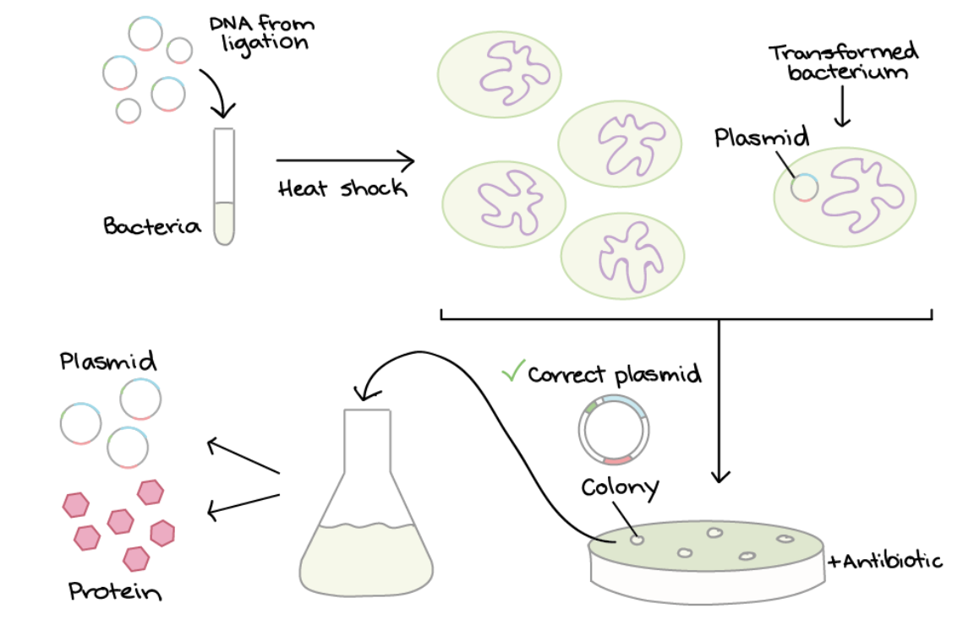
Bacterial Transformation and Selection
Plasmid with target gene
a low % of bacteria pick up plasmid
a low % of bacteria pick up plasmid
mix with bacteria
heat shock
”transformed”
Pick a colony and grow it up
grow bacteria on plates +antibiotic
only bacteria with plasmid (Ab resistance) grow

Slide 4

Bacterial Transformation
Use the movie in my lab folder
Notes:
Bacterial transformation movie

Slide 5
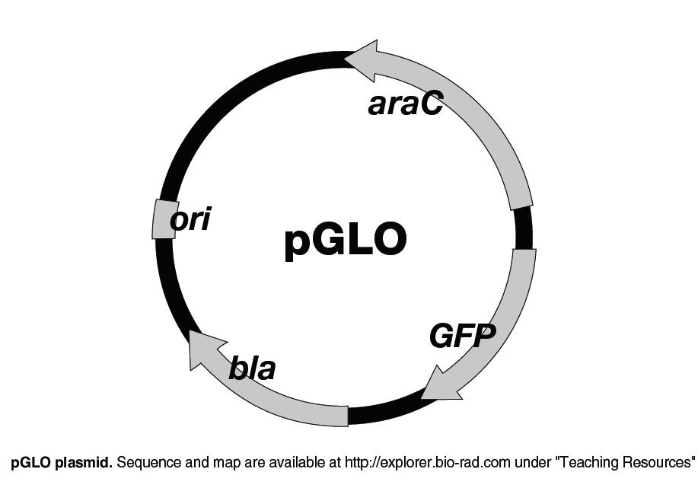
pGLO plasmid
1. Amp resistance gene
(bla: beta-lactamase)
  Allows bacteria to grow on plates with ampicillin
2. GFP gene
  Green Fluorescent Protein
3. araC gene
  Transcription factor that promotes expression of GFP
What else is on the plasmid?
Notes:
The sugar arabinose turns on expression of the GFP gene by binding to a
regulatory protein, araC, which sits on the PBAD promoter. When arabinose is
present, it binds to araC, consequently changing the conformation of araC
which facilitates transcription of the gene by RNA polymerase (see detailed
description in Appendix D). When exposed to UV light, the electrons in GFP’s
chromophere are excited to a higher energy state. When they drop down to a
lower energy state they emit a longer wavelength of visible
fluorrescent green light at 509 nm.

Slide 6

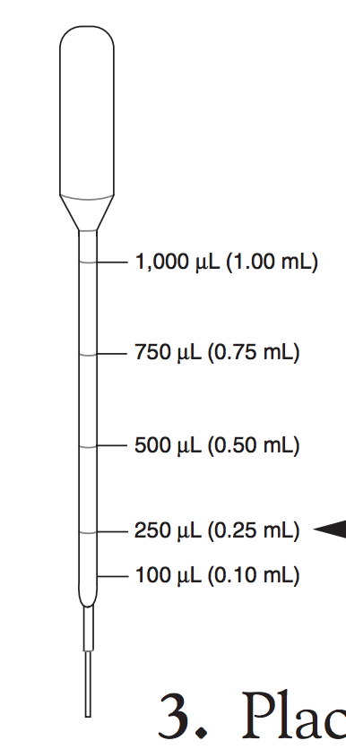
Procedure
+ pGLO
- pGLO
+pGLO | -pGLO
LB + amp | LB alone (no amp)
LB + amp + ara | LB + amp

Slide 7
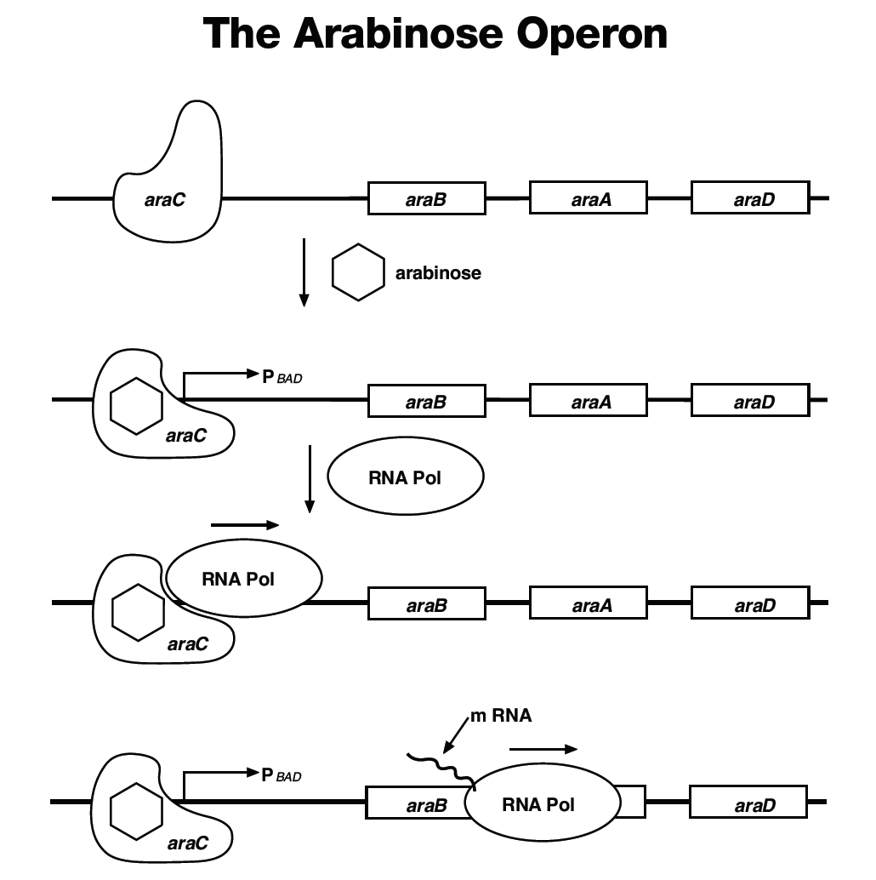
If arabinose is present, it acts as a transcription factor binding to the promoter and inducing expression of the three gene used in metabolizing (breaking down) arabinose

Slide 8
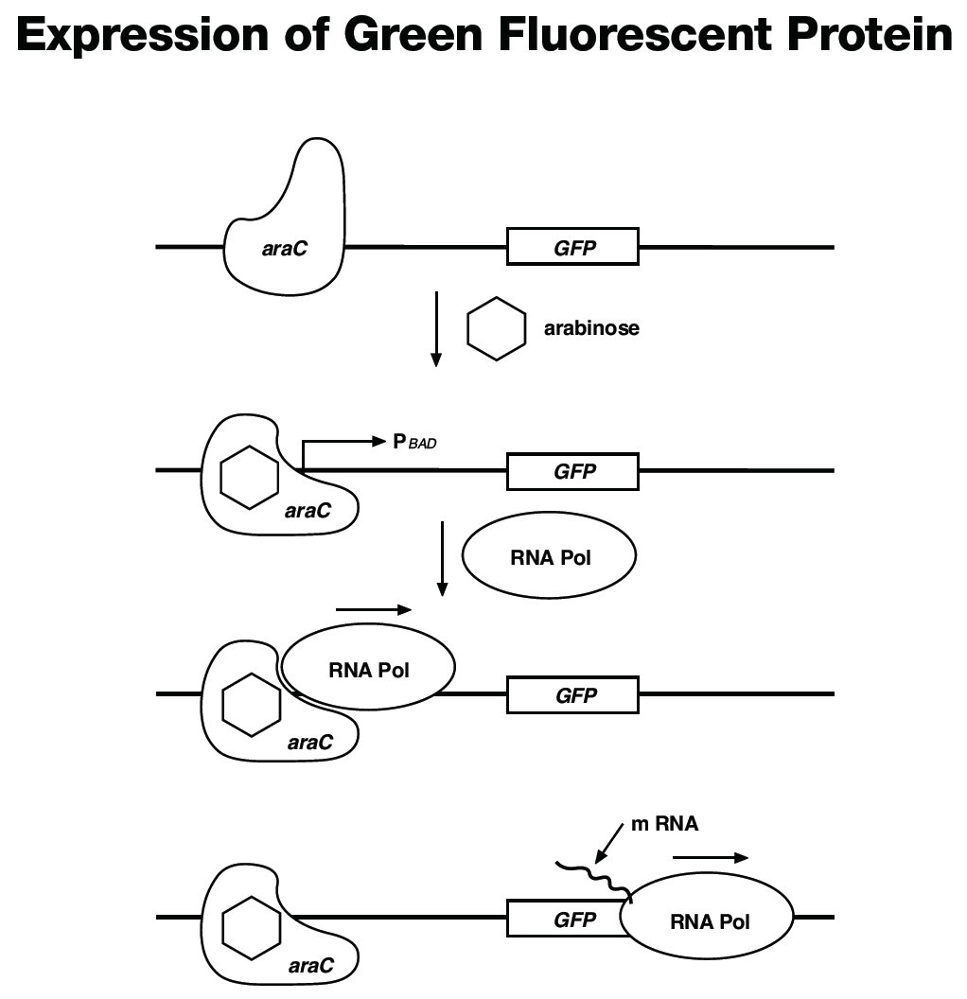
Put the arabinose operon promoter in front of GFP
If arabinose is present, it should bind the promoter and induce expression of GFP (which we should be able to see!)

Slide 9

